Slide 1


Stefan G.
11 Oct 2024

Slide 2

Outline
Executive Summary
Introduction
Methodology
Results
Conclusion
Appendix

Slide 3
Executive Summary
Summary of methodologies:
Data collection using Web Scraping and API
Perform Data Wrangling
Exploratory data analysis (EDA) (with visualization and SQL)
Visual analytics using Folium and Plotly Dash
Predictive analysis using classification models
Summary of all results
Success launches by site study
Correlation between different attributes and mission success rate

Slide 4
Introduction
Project background and context. Project aimed to highlight the importance of Data Science in Space Exploration:
Analyzing mission success rates
Predicting and optimizing launch costs
Improving spacecraft design and performance
Enhancing mission planning and risk assessment
Problems you want to find answers
What factors contribute most significantly to the success of SpaceX missions?
How has the cost-effectiveness of SpaceX launches evolved over time?
Can we predict the likelihood of a successful landing for future missions?
What impact has reusable rocket technology had on launch frequency and payload capacity?
Are there identifiable patterns in mission types or client distributions over the years?
Potential Data Points to Explore:
Launch dates and locations
Rocket types and their specifications
Payload mass and orbit types
Landing success rates for first stage boosters
Customer types (commercial, government, internal)
Mission costs and revenue (if available)

Slide 5

Section 1

Slide 6
Methodology
Executive Summary
Data collection methodology:
API Calls and Web scraping has been conducted to collect the data.
Perform data wrangling
Filters have been applied; missing values have been replaced.
Perform exploratory data analysis (EDA) using visualization and SQL
Perform interactive visual analytics using Folium and Plotly Dash
Perform predictive analysis using classification models

Slide 7
Data Collection
Datasets were collected using 2 main methods:
API Call:
.Endpoint identification
Authentication setup
Request parameters
JSON response parsing
Data extraction and storage
Web Scraping:
.Target URL identification
HTML structure analysis
Element selection
Data extraction
Cleaning and formatting
Common Steps:
.Data validation
Error handling
Rate limiting
Data integration
Storage in structured format

Slide 8
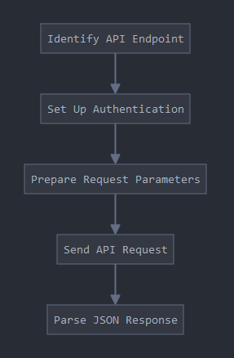
Data Collection – SpaceX API
Identify API Endpoint: Determine the specific SpaceX API endpoint you need to access for the required data.
Set Up Authentication: Prepare any necessary authentication tokens or keys required to access the SpaceX API.
Prepare Request Parameters: Define any query parameters, filters, or specific data requirements for your API call.
Send API Request: Make the HTTP request to the SpaceX API using the prepared endpoint, authentication, and parameters.
Parse JSON Response: Process the JSON data returned by the API into a usable format for your analysis.
GitHub URL

Slide 9
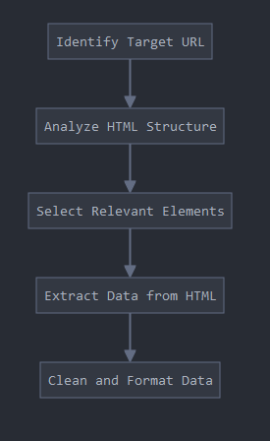
Data Collection - Scraping
Identify Target URL: Determine the specific web page(s) containing the SpaceX data you need to scrape.
Analyze HTML Structure: Inspect the HTML structure of the target page to locate the elements containing the desired data.
Select Relevant Elements: Use HTML tags, classes, or IDs to select the specific elements containing the SpaceX data.
Extract Data from HTML: Parse the selected HTML elements to extract the raw data.
Clean and Format Data: Process the extracted data into a structured format suitable for analysis.
GitHub URL

Slide 10
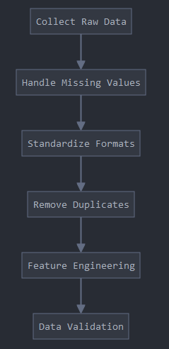
Data Wrangling
Collect Raw Data: Gather data from both API calls and web scraping methods.
Handle Missing Values: Identify and address any gaps in the dataset, either by imputation or removal.
Standardize Formats: Ensure consistency in data types, units, and representations across the dataset.
Remove Duplicates: Identify and eliminate any redundant entries in the dataset.
Feature Engineering: Create new variables or transform existing ones to better represent the information for analysis.
Data Validation: Perform final checks to ensure the data's integrity and readiness for analysis.
GitHub URL

Slide 11
EDA with Data Visualization
Flight Number vs. Payload Mass: Scatter plot showing the relationship between launch sequence and payload weight, indicating success or failure of each mission.
Flight Number vs. Launch Site: Scatter plot illustrating the distribution of launches across different sites over time, with success/failure indication.
Payload Mass vs. Launch Site: Scatter plot depicting the range of payload masses launched from each site, color-coded for mission outcomes.
Success Rate by Orbit Type: Bar chart comparing the success rates for different orbit types targeted by SpaceX missions.
Flight Number vs. Orbit: Scatter plot demonstrating how orbit types varied across successive launches, with success/failure indication.
Payload Mass vs. Orbit: Scatter plot showing the relationship between payload mass and targeted orbit, color-coded for launch outcomes.
SpaceX Yearly Average Launch Success Rate: Line chart tracking the trend of launch success rates over the years, showing SpaceX's improving performance.
GitHub URL

Slide 12
EDA with SQL
Display unique launch sites: Selected distinct Launch_Site from SPACEXTBL.
Show records with launch sites starting with 'CCA': Selected all columns where Launch_Site like 'CCA%', limited to 5 results.
Calculate total payload mass for NASA (CRS) missions: Summed PAYLOAD_MASS__KG_ where Customer like '%CRS%'.
Find average payload mass for F9 v1.1 boosters: Averaged PAYLOAD_MASS__KG_ where Booster_Version like '%F9 v1.1%'.
Determine date of first successful ground pad landing: Selected minimum date where Landing_Outcome = 'Success (ground pad)'.
List boosters with successful drone ship landings and payload between 4000-6000 kg: Selected Booster_Version meeting these criteria.
Count successful and failed missions: Counted records with 'Success' and 'Failure' in Mission_Outcome.
Identify boosters carrying maximum payload: Used subquery to find max PAYLOAD_MASS__KG_, then selected corresponding Booster_Version.
Display 2015 drone ship landing failures: Selected month, landing outcome, booster version, and launch site for specific criteria.
Rank landing outcomes between dates: Used window function to rank counts of landing outcomes between 2010-06-04 and 2017-03-20.
GitHub URL

Slide 13
Build an Interactive Map with Folium
Circles and Markers for launch sites:
Added a circle and marker for each SpaceX launch site.
Purpose: To visually represent the locations of launch sites on the map.
Marker Cluster for launch outcomes:
Created green markers for successful launches and red markers for failed launches.
Purpose: To show the distribution and success rate of launches at each site.
MousePosition:
Added a mouse position tracker to the map.
Purpose: To allow users to easily find coordinates of points of interest on the map.
Marker for coastline point:
Added a marker for the closest coastline point to a launch site.
Purpose: To visualize and calculate the distance between a launch site and the nearest coastline.
PolyLine:
Drew a line between a launch site and the selected coastline point.
Purpose: To visually represent the distance between the launch site and the coastline.
GitHub URL

Slide 14
Build a Dashboard with Plotly Dash
Dropdown menu for launch site selection:
Allows users to select a specific launch site or view data for all sites.
Purpose: To enable filtering of data based on launch site, providing more focused analysis.
Pie chart for launch success rates:
Shows total successful launches for all sites or success vs. failure for a specific site.
Purpose: To visualize the proportion of successful launches, either overall or for a particular site.
Range slider for payload mass:
Allows users to select a range of payload masses.
Purpose: To filter data based on payload mass, enabling analysis of how payload affects launch success.
Scatter plot for payload mass vs. launch success:
Displays the relationship between payload mass and launch success.
Color-coded by booster version category.
Purpose: To visualize how payload mass correlates with launch success, and how this relationship might vary across different booster versions.
Interactions:
The pie chart updates based on the selected launch site in the dropdown.
The scatter plot updates based on both the selected launch site and the payload range chosen in the slider.
GitHub URL

Slide 15
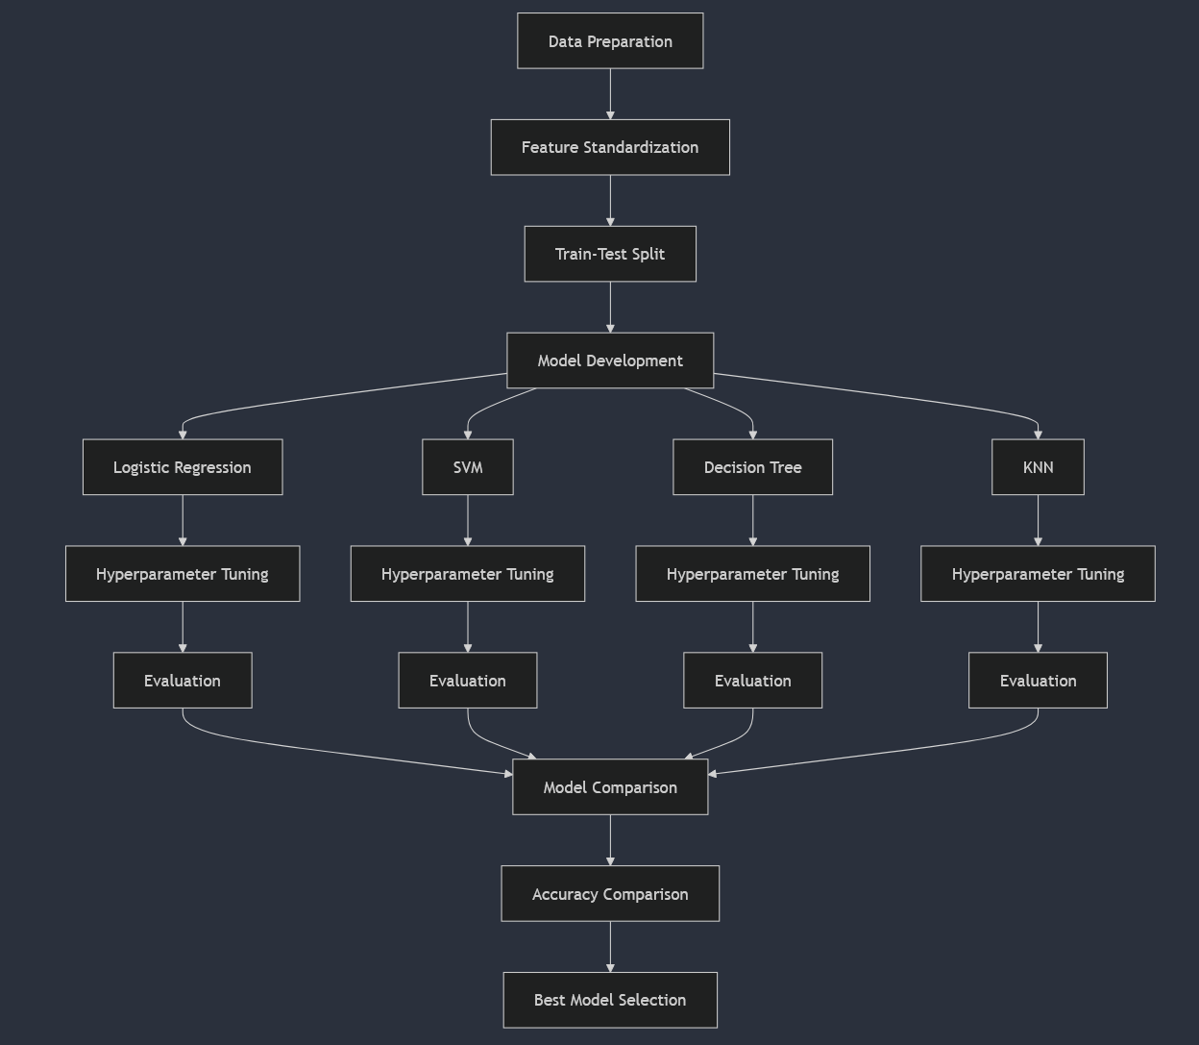
Predictive Analysis (Classification)
Data Preparation:
Loaded and standardized the data
Split data into training and test sets (80% train, 20% test)
Model Development:
Created four classification models:
Logistic Regression
Support Vector Machine (SVM)
Decision Tree
K-Nearest Neighbors (KNN)
Hyperparameter Tuning:
Used GridSearchCV with 10-fold cross-validation for each model
Defined parameter grids for each model type
Model Evaluation:
Assessed each model's performance using accuracy on test data
Created confusion matrices for visual evaluation
Model Comparison:
Compared accuracies of all models on test data
Identified the best performing model
GitHub URL

Slide 16
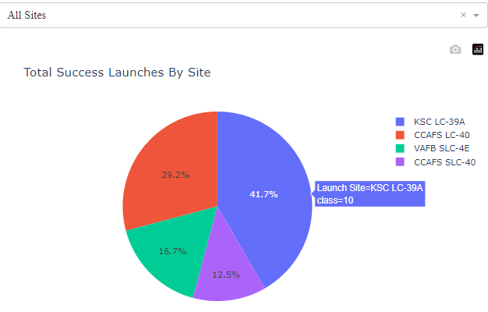
Results
Exploratory data analysis results
SpaceX's launch success rates improved over time across various orbits and payload masses, with certain launch sites and orbit types showing higher success rates, demonstrating the company's growing capabilities and operational efficiency.
Interactive analytics demo in screenshots →
Predictive analysis results
Logistic Regression: 83.33% accuracy on test data
Support Vector Machine: 83.33% accuracy on test data
Decision Tree: 77.78% accuracy on test data
K-Nearest Neighbors: 83.33% accuracy on test data
The best performing model was Logistic Regression, although it tied with SVM and KNN in terms of test accuracy. The document also mentions using confusion matrices to visualize the performance of each model, but the actual matrices are not included in the text.

Slide 17

Section 2

Slide 18
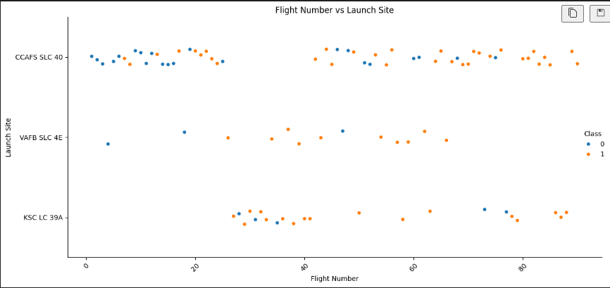
Flight Number vs. Launch Site
Flight Number vs. Launch Site: Scatter plot illustrating the distribution of launches across different sites over time, with success/failure indication.

Slide 19
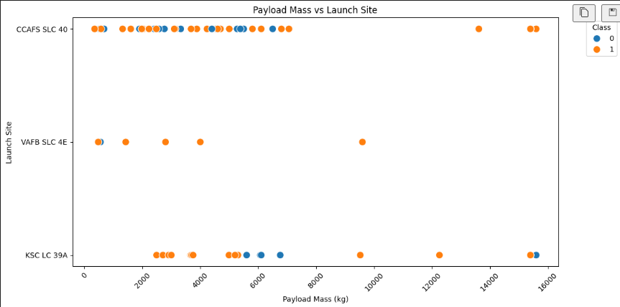
Payload vs. Launch Site
Payload Mass vs. Launch Site: Scatter plot depicting the range of payload masses launched from each site, color-coded for mission outcomes.

Slide 20
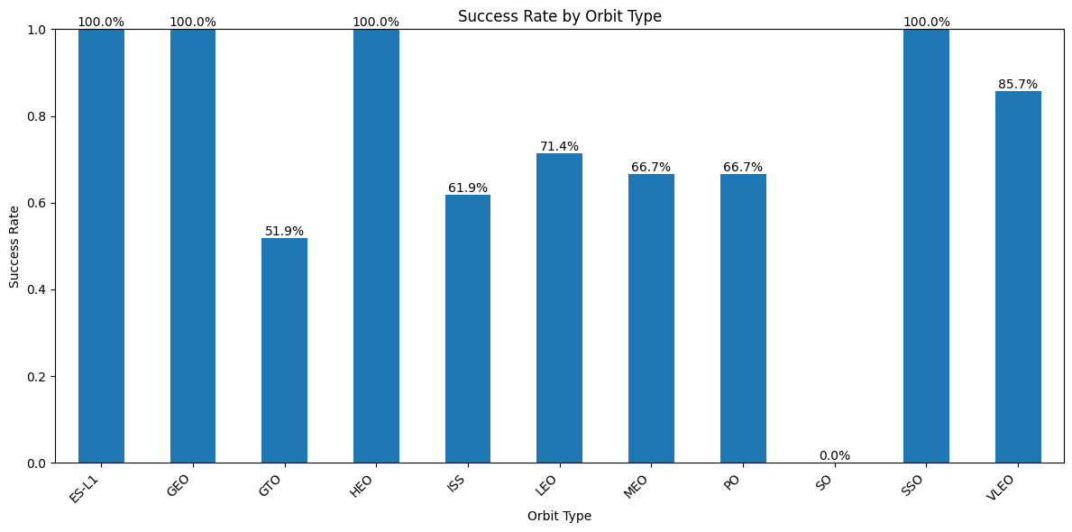
Success Rate vs. Orbit Type
Success Rate by Orbit Type: Bar chart comparing the success rates for different orbit types targeted by SpaceX missions.

Slide 21
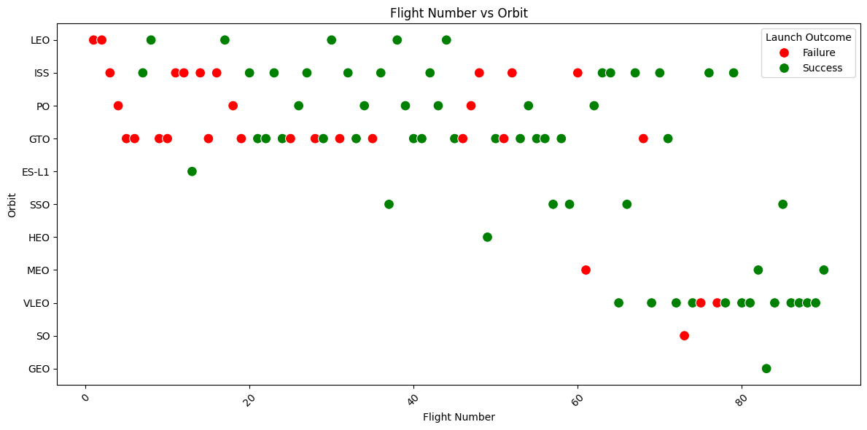
Flight Number vs. Orbit Type
Flight Number vs. Orbit: Scatter plot demonstrating how orbit types varied across successive launches, with success/failure indication.

Slide 22
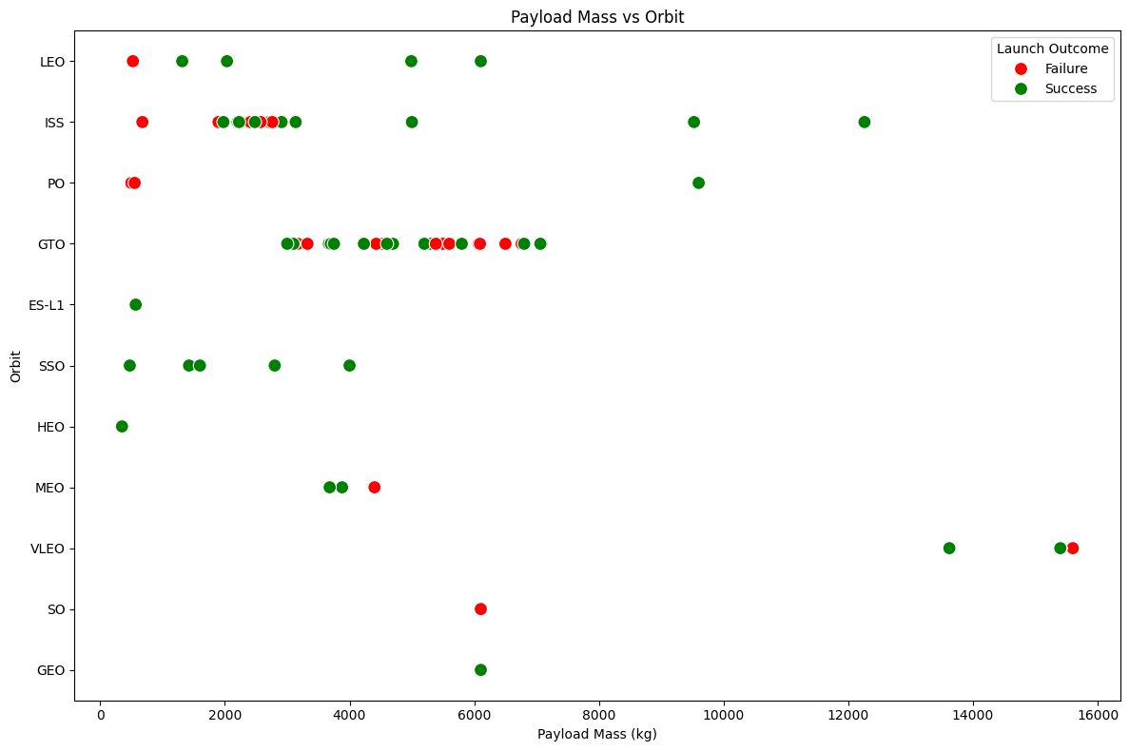
Payload vs. Orbit Type
Payload Mass vs. Orbit: Scatter plot showing the relationship between payload mass and targeted orbit, color-coded for launch outcomes.

Slide 23
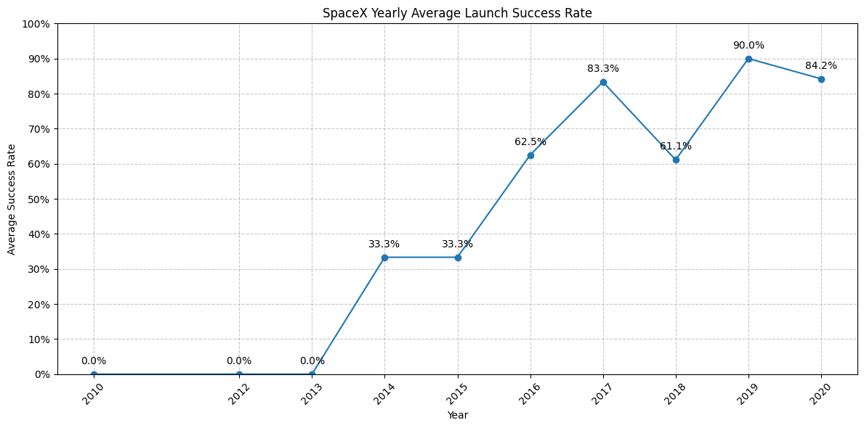
Launch Success Yearly Trend
SpaceX Yearly Average Launch Success Rate: Line chart tracking the trend of launch success rates over the years, showing SpaceX's improving performance.

Slide 24
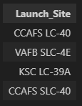
All Launch Site Names
Find the names of the unique launch sites
Present your query result with a short explanation here
Display unique launch sites: Selected distinct Launch_Site from SPACEXTBL.

Slide 25
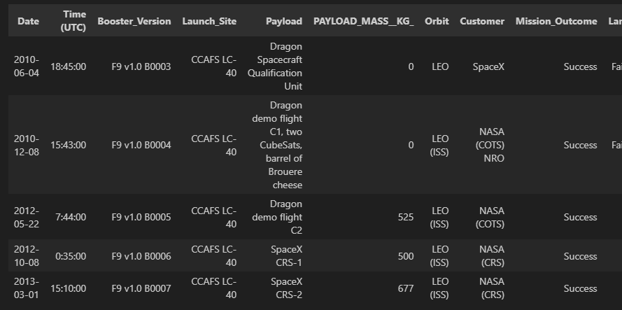
Launch Site Names Begin with 'CCA'
Find 5 records where launch sites begin with `CCA`
Present your query result with a short explanation here
Show records with launch sites starting with 'CCA': Selected all columns where Launch_Site like 'CCA%', limited to 5 results.

Slide 26
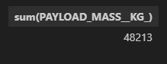
Total Payload Mass
Calculate the total payload carried by boosters from NASA
Present your query result with a short explanation here
Calculate total payload mass for NASA (CRS) missions: Summed PAYLOAD_MASS__KG_ where Customer like '%CRS%'.

Slide 27
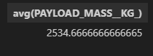
Average Payload Mass by F9 v1.1
Calculate the average payload mass carried by booster version F9 v1.1
Present your query result with a short explanation here
Find average payload mass for F9 v1.1 boosters: Averaged PAYLOAD_MASS__KG_ where Booster_Version like '%F9 v1.1%'.

Slide 28
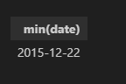
First Successful Ground Landing Date
Find the dates of the first successful landing outcome on ground pad
Present your query result with a short explanation here
Determine date of first successful ground pad landing: Selected minimum date where Landing_Outcome = 'Success (ground pad)'.

Slide 29
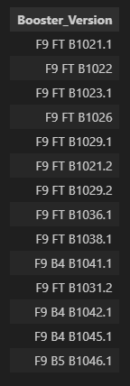
Successful Drone Ship Landing with Payload between 4000 and 6000
List the names of boosters which have successfully landed on drone ship and had payload mass greater than 4000 but less than 6000
Present your query result with a short explanation here
List boosters with successful drone ship landings and payload between 4000-6000 kg: Selected Booster_Version meeting these criteria.

Slide 30
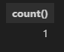
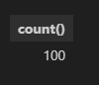
Total Number of Successful and Failure Mission Outcomes
Calculate the total number of successful and failure mission outcomes
Present your query result with a short explanation here
Count successful and failed missions: Counted records with 'Success' and 'Failure' in Mission_Outcome.

Slide 31
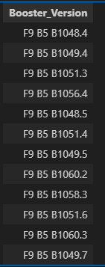
Boosters Carried Maximum Payload
List the names of the booster which have carried the maximum payload mass
Present your query result with a short explanation here
Identify boosters carrying maximum payload: Used subquery to find max PAYLOAD_MASS__KG_, then selected corresponding Booster_Version.

Slide 32
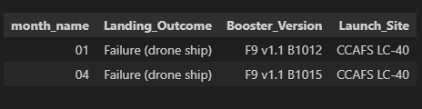
2015 Launch Records
List the failed landing_outcomes in drone ship, their booster versions, and launch site names for in year 2015
Present your query result with a short explanation here
Display 2015 drone ship landing failures: Selected month, landing outcome, booster version, and launch site for specific criteria.

Slide 33
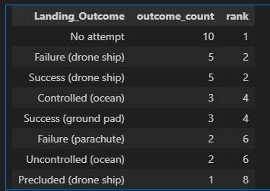
Rank Landing Outcomes Between 2010-06-04 and 2017-03-20
Rank the count of landing outcomes (such as Failure (drone ship) or Success (ground pad)) between the date 2010-06-04 and 2017-03-20, in descending order
Present your query result with a short explanation here
Rank landing outcomes between dates: Used rank() function to rank counts of landing outcomes between 2010-06-04 and 2017-03-20.

Slide 34

Section 3

Slide 35
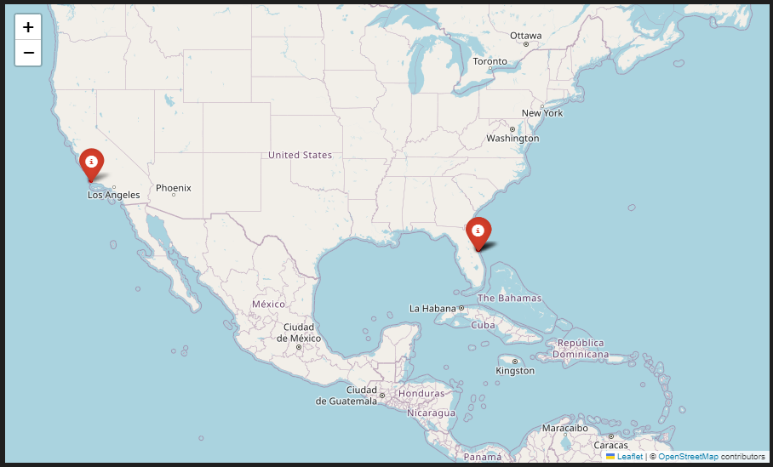
All launch sites
Explore the generated folium map and make a proper screenshot to include all launch sites’ location markers on a global map
Explain the important elements and findings on the screenshot
All sites are close to the Equator line and also close to the coast.

Slide 36
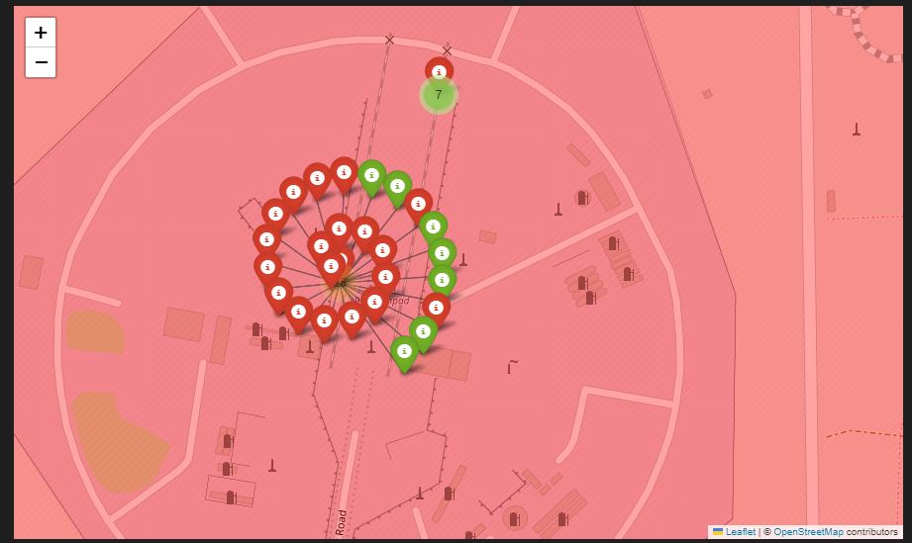
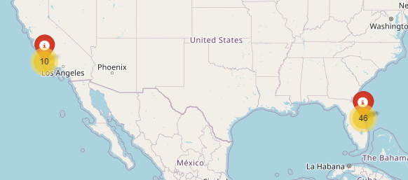
Color-labeled launch outcomes
Explore the folium map and make a proper screenshot to show the color-labeled launch outcomes on the map

Slide 37
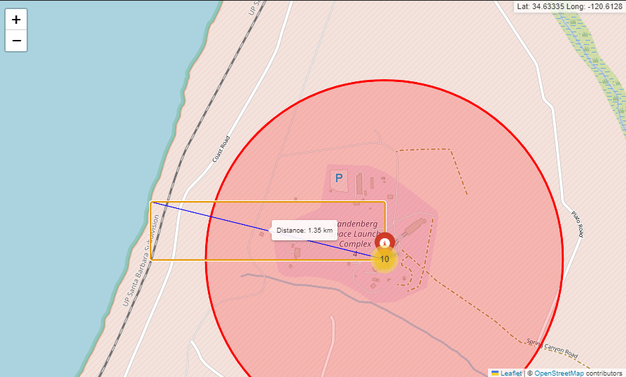
Launch site proximities
Explore the generated folium map and show the screenshot of a selected launch site to its proximities such as railway, highway, coastline, with distance calculated and displayed

Slide 38

Section 4

Slide 39
Total success launches by site – All sites
Show the screenshot of launch success count for all sites, in a piechart

Slide 40
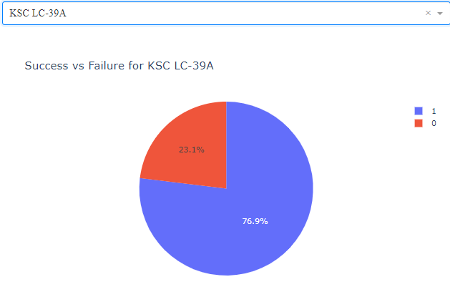
Launch site with highest launch success ratio
Show the screenshot of the piechart for the launch site with highest launch success ratio

Slide 41
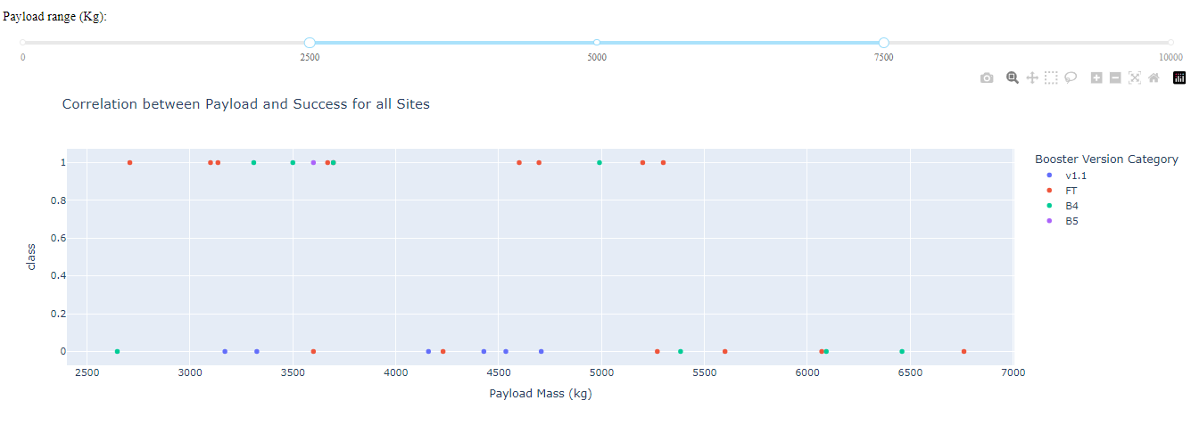
Payload vs. Launch Outcome
Show screenshots of Payload vs. Launch Outcome scatter plot for all sites, with different payload selected in the range slider

Slide 42

Section 5

Slide 43
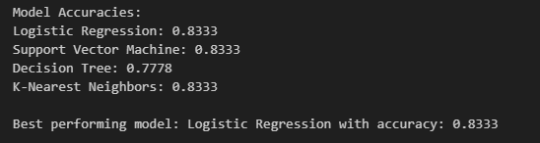
Classification Accuracy
Visualize the built model accuracy for all built classification models, in a bar chart
Find which model has the highest classification accuracy

Slide 44
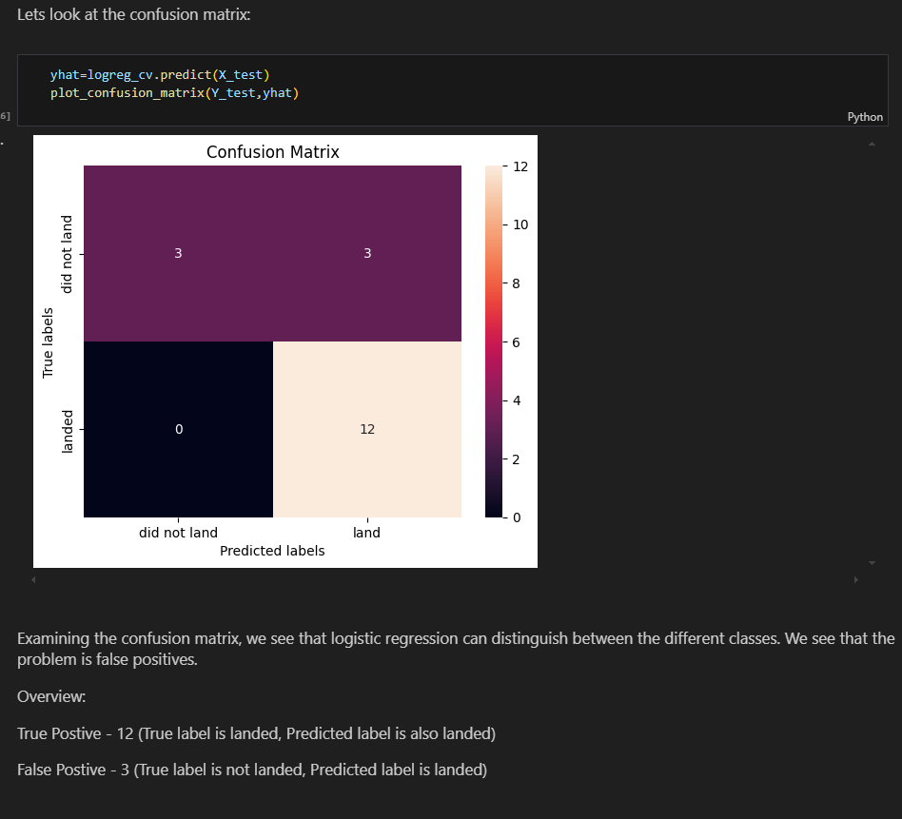
Confusion Matrix
Show the confusion matrix of the best performing model with an explanation

Slide 45
Conclusions
SpaceX's launch success rates improved over time, showing technological advancement and learning.
Heavier payloads became more manageable in later missions, indicating improved rocket capabilities.
Different launch sites showed varying capabilities in handling payload masses and mission types.
Certain orbit types (e.g., Polar, LEO, ISS) had higher success rates for heavier payloads.
The VAFB SLC-4E launch site had limitations for very heavy payloads (over 10,000 kg).
Success rates varied among different orbit types, suggesting varying degrees of mission difficulty.
LEO missions showed a positive correlation between more flights and higher success rates.
GTO missions didn't show a clear relationship between flight number and success rate.
The interactive dashboard enables detailed exploration of launch data, allowing for custom analysis.
Machine learning models (Logistic Regression, SVM, KNN) achieved around 83% accuracy in predicting launch outcomes.
The Decision Tree model performed slightly worse than other models in predicting launch success.
The analysis provides valuable insights for understanding SpaceX operations and potentially predicting future launch successes.

Slide 46
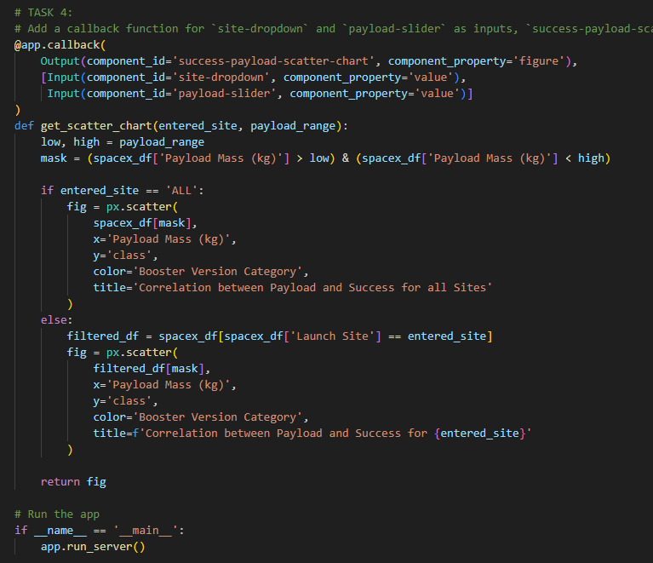
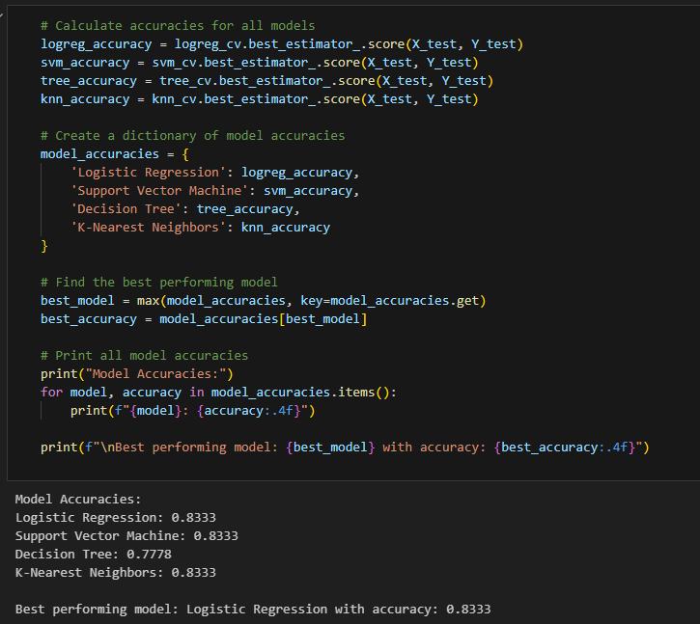
Appendix
Include any relevant assets like Python code snippets, SQL queries, charts, Notebook outputs, or data sets that you may have created during this project

Slide 47
Above and Beyond! Suggestions based on the data analysis..
Improve Heavy Payload Capacity • Invest in R&D for stronger propulsion systems • Optimize vehicle design for heavier loads
Optimize Launch Sites • Upgrade VAFB SLC-4E to handle heavier payloads • Analyze success factors of high-performing sites
Enhance GTO Mission Success • Focus on developing GTO-specific technologies • Investigate factors affecting GTO mission success rates
Expand Reusability • Increase first stage reuse frequency • Develop reusable second stage technology
Diversify Orbit Capabilities • Expand capabilities for diverse orbit types • Research new market opportunities in unexplored orbits
Implement Continuous Improvement Strategies • Conduct regular data analysis and modeling • Implement machine learning for predictive maintenance • Enhance weather prediction capabilities for launches
Pursue Future Initiatives • Develop interplanetary mission capabilities • Advance the Starship program • Explore and develop space tourism opportunities

Slide 48
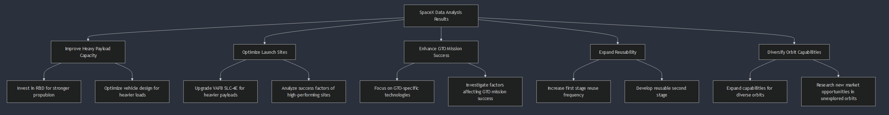
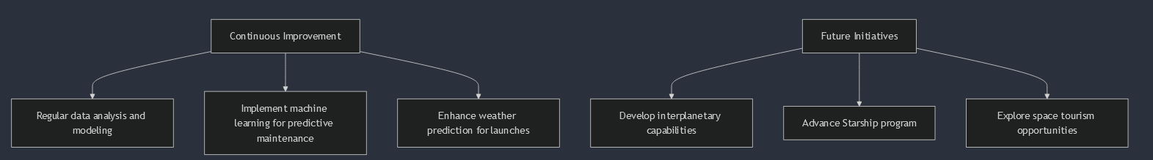
Above and Beyond! Suggestions based on the data analysis..

Slide 49


